Slide 1

welcome

Slide 2
Identity
A.K.M. Badiuzzaman
Head Teacher
1. No.Kabakhali Govt.Primary School
Dighinala,khagrachari

Slide 3
Class-One
Subject-English For Today

Slide 4
LEARNING OUTCOMES
By the end of this lesson student will be
able-
1. To enjoy the rhyme.
2.to recite the rhyme with correct stress
and intonation.

Slide 5
Video

Slide 6
Declare the lesson
Rain , rain , go away

Slide 7
Lesson Unit-
Rain,rain,go ……………………..
Rain, rain ,go away.

Slide 8
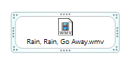
video

Slide 9

Teachers recitation

Slide 10
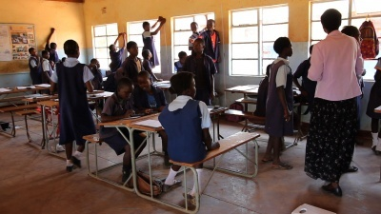
Group work-
teacher and student

Slide 11
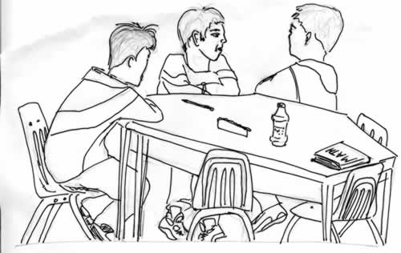
Group work- Student
And student with chain drill

Slide 12
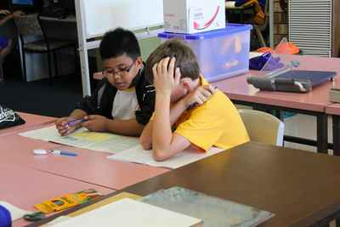
Pair work-

Slide 13
Now open your EFT book
Page No – 37

Slide 14

Check learning
I/W work

Slide 15
Home work
Read the rhyme

Slide 16


Good bye

